Slide 1
MDPH AND LOCAL PUBLIC HEALTH
Strengthening a Culture of Collaboration
Coalition for Local Public Health
ORIENTATION TO LOCAL PUBLIC HEALTH IN MASSACHUSETTS
June 19, 2018
Ron O’Connor, Director
Office of Local and Regional Health
Massachusetts Department of Public Health

Slide 2
Presentation overview
DPH Vision and Mission
DPH Support for Local Public Health
Special Commission on Local and Regional Public Health

Slide 4
DPH support for local public health
History
Internal and External Collaboration
DPH Programs
Funding for Capacity Building

Slide 5
DPH and Local Public Health
DPH values the essential role of local public health in protecting and improving health
DPH is committed to working collaboratively to address longstanding and emerging local public health challenges

Slide 6
History of DPH Approach to Supporting Local Public Health
Prior to 1990
Office of Local and
Regional Health
(regional approach)
1990-2013
support for mandated services/ other categorical funding
2013 to present
Office of Local and
Regional Health
(statewide approach)

Slide 7
DPH Internal/External Coordination
Improve coordination across the Department as our relationships with local public health have expanded to include more programs
Strengthen partnership and collaboration with external stakeholder groups (e.g., CLPH)
Make it easier for local public health and other stakeholders to identify who to contact and how to work with DPH effectively

Slide 8
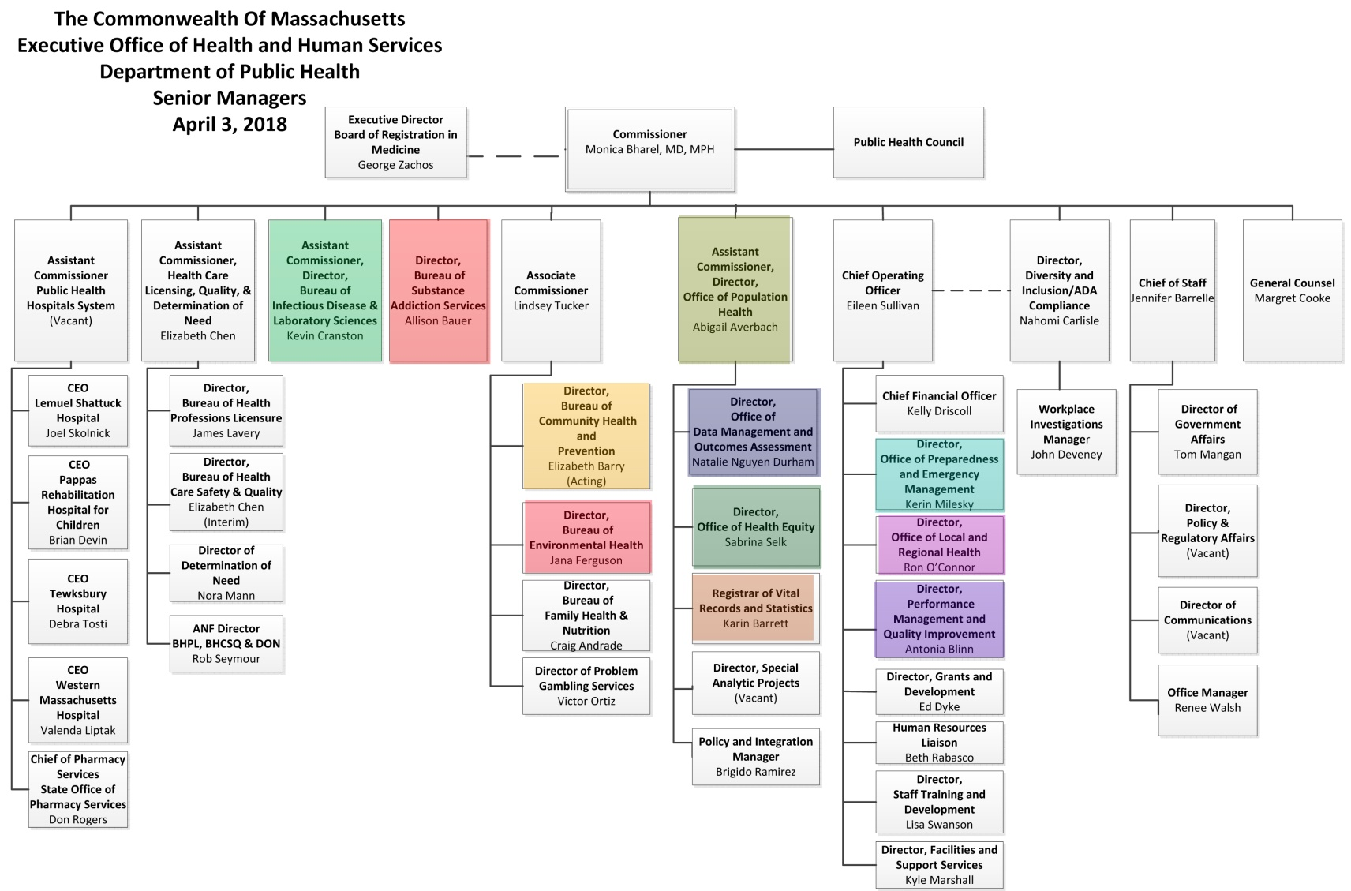

Slide 9
DPH Intra-Agency Collaboration
Local Public Health
Working Group
Bureau of Environmental Health
Bureau of Infectious Disease and Laboratory Sciences
Office of Preparedness and Emergency Management
Registry of Vital Records and Statistics
Performance Management and Quality Improvement
Office of Local and Regional Health
Office of Health Equity
Bureau of Substance Use and Addiction Services
Bureau of Community Health and Prevention
Office of Population Health
Office of Data Management and Outcomes Assessment

Slide 10
DPH Programs
Community Sanitation
Food Protection
Preparedness and Emergency Management
Substance Addiction
Health Equity
Infectious Disease
Tobacco Control
Accreditation
Municipal Wellness

Slide 11
Preventive Health Block Grant
Local and Regional Public Health Capacity Building Project
Coalition for Local Public Health
Member Organizations Support
Coordination
Legal Technical Assistance
Local Public Health Institute (also OPEM funding)
OLRH Staff

Slide 12
Special commission on local and regional public health
Why Special Commission
Commission Charge
Commission Progress
Next Steps

Slide 13
Why Special Commission?
Inconsistency across communities
Small towns struggle
Variability in board and staff credentials
Limited ability to meet accreditation standards
Shared services proceeding slowly
From Strengthening the Local and Regional Public Health System.
Massachusetts Public Health Association (2016)

Slide 14
Massachusetts Communities by Population Size

Slide 15
Commission Charge
“…assess the effectiveness and efficiency of municipal and regional public health systems and to make recommendations regarding how to strengthen the delivery of public health services..”

Slide 16
Assessment and Recommendations
Capacity of local public health
in comparison to national standards
to carry out their statutory powers and duties
Existing resources for local health
Workforce credentials
Regional collaboration and various models of service delivery

Slide 17
Commission Progress
Case for Change
What is the minimum set of public health services that all Massachusetts residents should expect from the public health system?
Structure
What is the most effective and efficient way to design the local public health system to meet the standard?
Workforce
What local public health workforce credentials and training are needed to ensure that they can provide the minimum set of services?
Standard
Why is it important to build a more efficient and effective local public health system?

Slide 18
Foundational Public Health Services
https://vimeo.com/204406975

Slide 19
Commission Next Steps
Commission Status Report (May 2018)
Stakeholder Listening Sessions (June 4-15, 2018)
Draft Recommendations (Fall 2018)
Public Hearings (Late Fall 2018)
Final Report and Recommendations (Winter 2019)

Slide 20
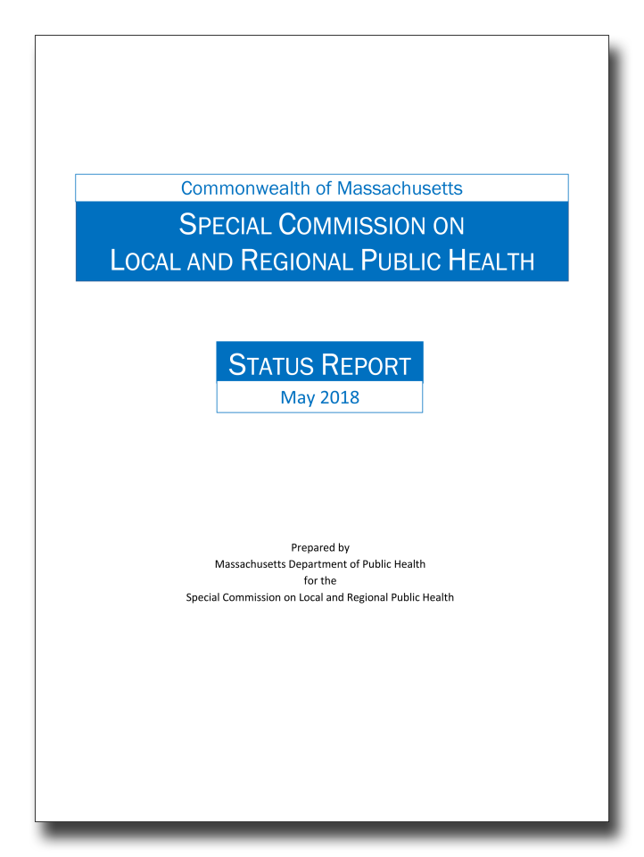
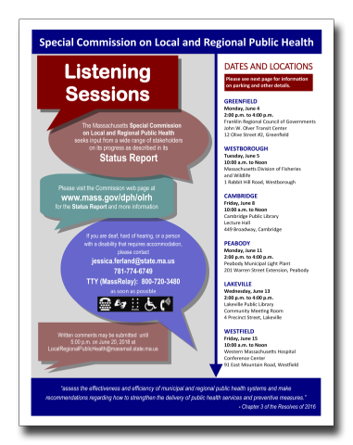
Status Report
Highlights work to date of Commission and its subcommittees
Data
Structure
Standards
Workforce Credentials
Feedback through stakeholder listening sessions (June 4-15)
Written comments until 5:00 p.m. on June 20, 2018 at
LocalRegionalPublicHealth@massmail.state.ma.us

Slide 21
OLRH Team
Ron O’Connor, Director
Shelly Yarnie, Director of Local Public Health Initiatives
Erica Piedade, Directors of Local Public Health Initiatives
Jessica Ferland, Local Public Health Program Coordinator
To be hired, Communications and Data Specialist

Slide 22
Thank you
Questions?

